Slide 1
Lecture 4A: Third-Party Components & Expo Libraries

Slide 2
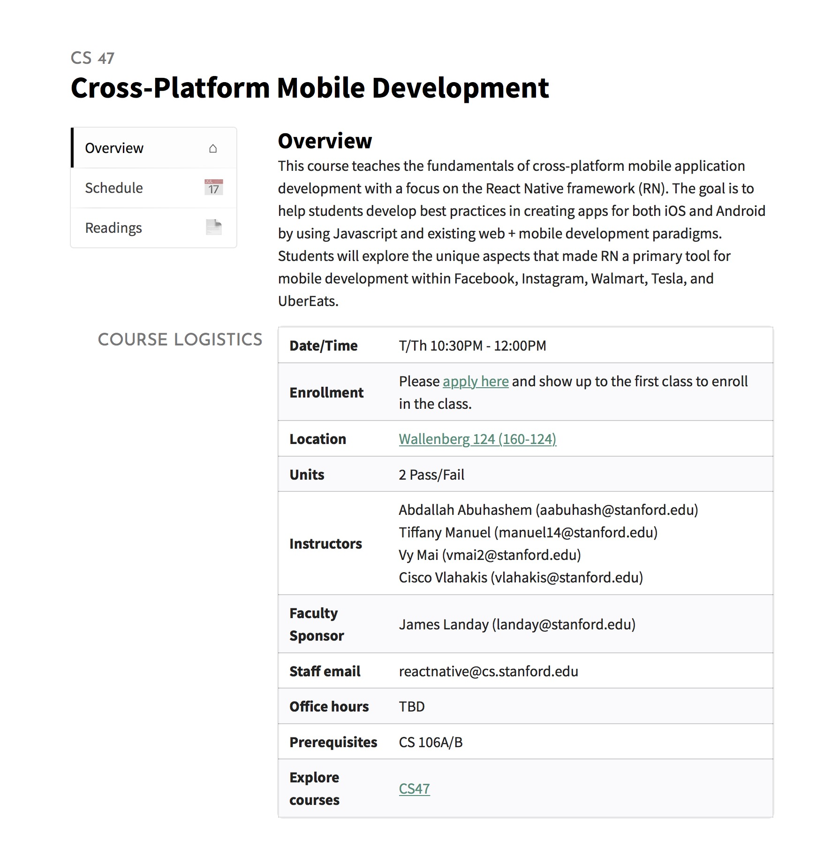
https://cs47.stanford.edu
To access lectures use Stanford email

Slide 3

Live Exercise
To-Do List
Run npm install
Open with Expo

Slide 4
Passing Function As Props
Fat Arrows Only
export default class App extends React.Component {
const handlePress = () => {
console.log('Click happened');
}
render() {
return (
<CustomButton
title="Click me"
handlePress={() => this.handlePress()}
/>
);
}
}
1
Write the function you want to pass in as a prop.
2
Pass the function as a prop using a fat arrow function.
USEFUL LINKS / React Native Docs

Slide 5
Passing Function As Props
Fat Arrows Only
export default function CustomButton(props) {
render() {
return (
<Button
title={props.title}
onPress={props.handlePress}
/>
);
}
}
Call the function in the child component
MORE IN-DEPTH
Snack Example
USEFUL LINKS / React Native Docs

Slide 6
Follow along code
https://reflect.sh/sole-sister
Live Exercise
To-Do List
Complete part 1

Slide 7
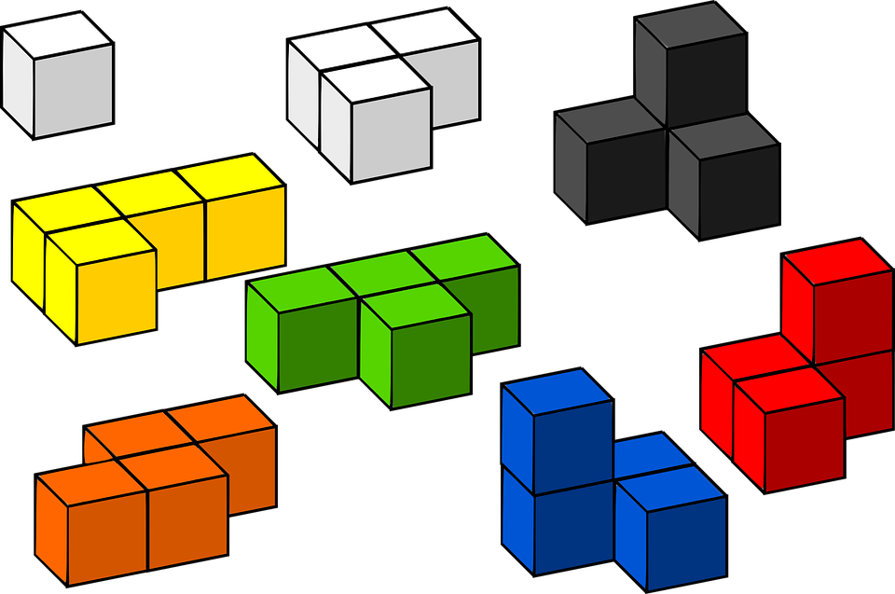
Components
Building Blocks of React Native
Building blocks
React Native Components
Custom Components
Third-Party Components

Slide 8
Components
Building Blocks of React Native
Building blocks
React Native Components
Custom Components
Third-Party Components

Slide 9

Third-Party Components
Reduce, Reuse & Recycle
WHY?
Don’t reinvent the wheel
Same time and energy

Slide 10
Third-Party Components
Reduce, Reuse & Recycle
HOW?
cd into project directory
Run npm install <third-party library> --save NOTE: --save is super important because it saves the library in package.json.
1
2
Notes:
If you don’t use --save, the library will not be saved in your package.json. And when someone else downloads your project and runs npm install, the project will not know to install that library, and the person will need to manually install the library. That is, if they can even tell which library it is.

Slide 11
Third-Party Components
Reduce, Reuse & Recycle
{
"main": "node_modules/expo/AppEntry.js",
"scripts": {
"start": "expo start",
"android": "expo start --android",
"ios": "expo start --ios",
"web": "expo start --web",
"eject": "expo eject"
},
"dependencies": {
"expo": "^35.0.0",
"react": "16.8.3",
"react-dom": "16.8.3",
"react-native": "https://github.com/expo/react-native
"react-native-web": "^0.11.7",
“third-party-library”: “^0.1”
},
"devDependencies": {
"babel-preset-expo": "^7.0.0"
},
"private": true
}
HOW?
cd into project directory
Run npm install <third-party library> --save NOTE: --save is super important because it saves the library in package.json.
1
2
package.json
Notes:
Here is an example

Slide 12



Third-Party Libraries
Reduce, Reuse & Recycle
React Native Elements
NativeBase
Expo Components See API Reference on sidebar for list of components.

Slide 13
Follow new code
https://reflect.sh/sole-sister
Live Exercise
To-Do List
Complete part 2
Native Base CheckBox
Notes:
See https://docs.nativebase.io/Components.html#checkbox-headref for help

Slide 14
Expo Libraries
Reduce, Reuse & Recycle
LinearGradient
Font
Camera
ImagePicker
WebView
Constants
etc
NOTE: Some components do not need to be expo install-ed and come with Expo. Some do need to be expo install-ed. Read the documentation for each specific component to understand which cases require extra installation.

Slide 15
Expo Vector Icons
Reduce, Reuse & Recycle
Expo Documentation
Searchable Directory of Vector Icons
Notes:
For now, avoid using MaterialCommunityIcons, they have not worked in the past for some mysterious reason.

Slide 16
Follow along code
https://reflect.sh/sole-sister
Live Exercise
To-Do List
Complete part 3
Vector Icons

Slide 17

Third-Party Components
Reduce, Reuse & Recycle
You can also download singular components from the npm registry:
react-native-swipe-gestures
react-native-modal
react-native-animatable
NOTE: Some components require linking, which then requires ejecting from Expo. For now, it is much simpler to avoid using such components.
Notes:
Instead of full libraries, you can download singular components if you just want one specific UI.

Slide 18
Follow along code
https://reflect.sh/sole-sister
Live Exercise
To-Do List
Complete part 4
react-native-swipe-gesture
Notes:
See https://www.npmjs.com/package/react-native-swipe-gesture for help.

Slide 19
Live Exercise
To-Do List
Final Code
https://github.com/stanford-cs47/Lecture4a-Final
Follow along code
https://reflect.sh/sole-sister
Notes:
See https://www.npmjs.com/package/react-native-swipe-gesture for help.

Slide 20
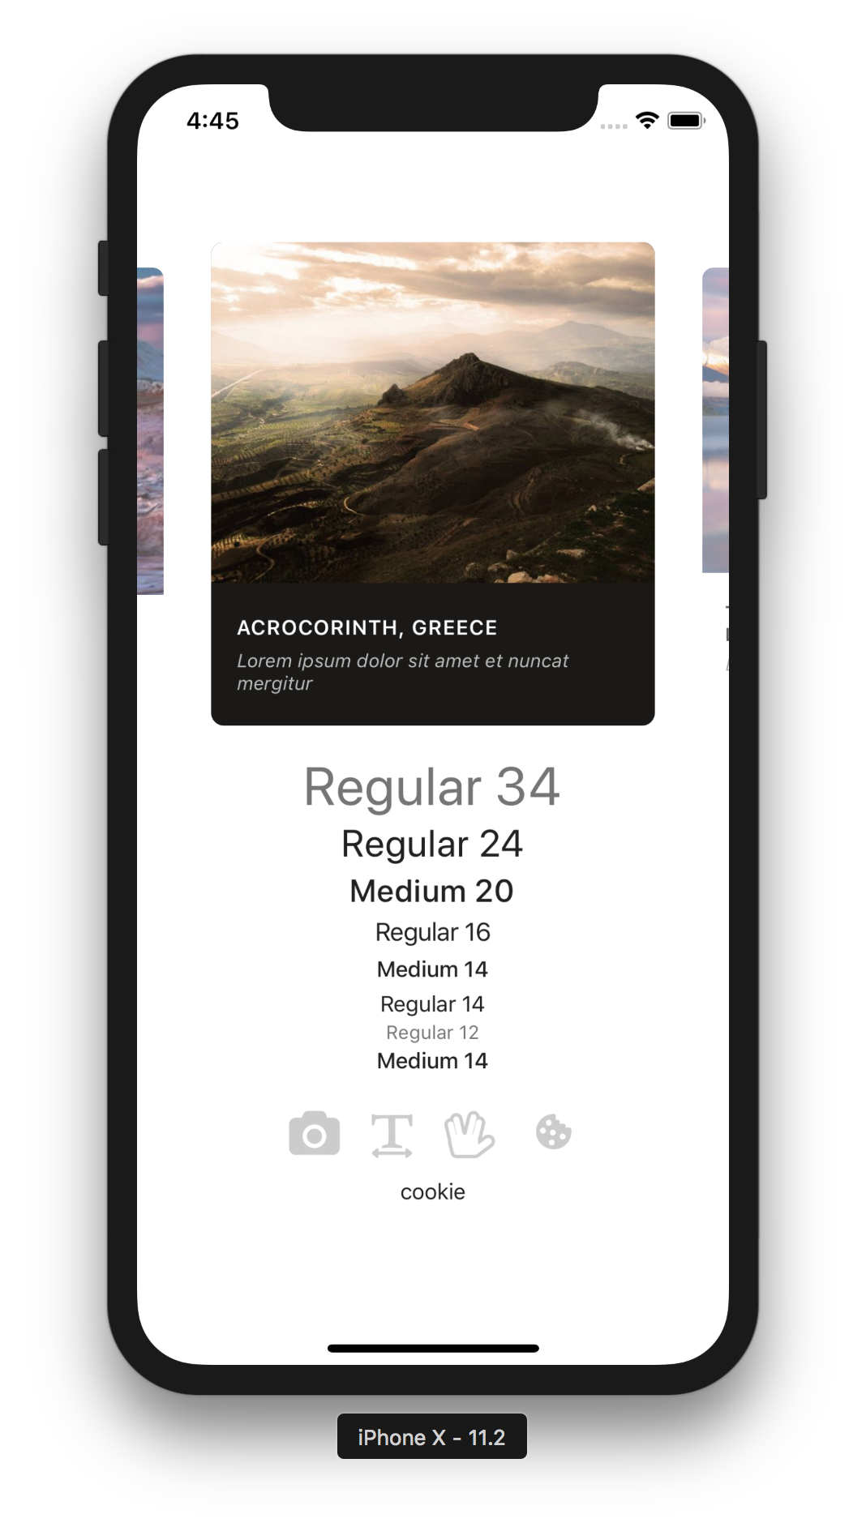

Slide 21
Snap Carousel
https://github.com/archriss/react-native-snap-carousel

Slide 22
Snap Carousel
Typography
https://github.com/hectahertz/react-native-typography

Slide 23
Snap Carousel
Typography
Vector Icons
https://github.com/oblador/react-native-vector-icons
https://expo.github.io/vector-icons/

Slide 24
Snap Carousel
Typography
Vector Icons
Animatable
https://github.com/oblador/react-native-animatable

Slide 25
Snap Carousel
Typography
Vector Icons
Animatable
Notes:
debugWorker.js
https://github.com/archriss/react-native-snap-carousel
https://github.com/hectahertz/react-native-typography
https://github.com/oblador/react-native-animatable
https://github.com/oblador/react-native-vector-icons

Slide 26
Exercise
Extend your ToDo app with any third-party component.
SOME IDEAS:
Add a clickable ‘X’ vector icon to make each ToDo deleteable (again)
Use a third-party button element to clear the entire list of items (Native Base or React Native Elements)
Make a toast appear when you add and/or delete an item (Native Base)
Google a functionality/UI you want to have and try to use a third-party component that pops up

Slide 27

Office Hours
Email us directly if you’re not available at these times
Abdallah AbuHashem
Monday (12-1 PM) @ Huang Basement
Or by appointment
Vy Mai
Tuesday (3-4 PM) @ Old Union
Or by appointment
Cisco Vlahakis
Wednesday (8-9 PM) @ Huang Basement
Or by appointment
Tiffany Manuel
Thursday (2-3 PM) @ Huang Basement
Or by appointment
For today’s attendance, please see #general channel in our Slack.
Invitation:
https://tinyurl.com/cs47slack2019

Slide 28
Lecture 4A: Third-Party Components & Expo Libraries

